Slide 1
DRINKING WATER and Clean water state REVOLVING FUND
(DWsRF AND cwsrf)
PROJECT PLAN
PUBLIC HEARING
April 03, 2023
PRESENTED TO THE MAYOR AND CITY COUNCIL AND THE RESIDENTS OF THE CITY OF Lincoln Park BY:
James D. Hollandsworth, P.E, P.S.
Project Manager

Slide 2
PROJECT TEAM
City of Lincoln Park
John Kozuh, Department of Public Services Director
DWS Staff
Hennessey Engineers, Southgate, Michigan (HEI)
City of Lincoln Park’s Engineering Consultant
James Hollandsworth, P.E., P.S., Project Manager
Tiffany Neubig, F.E. Project Team
Khal Hanna, Project Team
Various Construction Observation Staff
Fishbeck, Michigan
Expertise in Flow Monitoring and Computer Simulated Modeling, Pump Station/RTB Evaluation
Jeff Brown, P.E., Project Manager
Caitlin Wineka, Water and Wastewater Engineer

Slide 3
OVERVIEW
Overview of DWSRF Program
Drinking Water Quality Problems to be addressed
DWSRF Proposed Projects Scope
Overview of CWSRF Program
Clean Water Quality Problems to be addressed
CWSRF Project Scope
Project Plan Timeline
DWRSF Project Costs
CWSRF Project Costs
Social and Environmental Impacts
QUESTIONS

Slide 4
OVERVIEW OF DWsRF and cwsrf LOAN
PROGRAM
Low-interest loan program through EGLE
20-year loan, typically at 1.875 percent interest
Significantly Overburdened Status may qualify the city of Lincoln Park for a 30-year loan
Assists with the funding of water distribution system improvements
Water Main and Lead Water Service Leads Replacements
Final project plan for CWSRF must be submitted by May 1 and the DWSRF by June 1 for inclusion on the project priority list.
The priority lists is usually issued in August of each year.

Slide 5
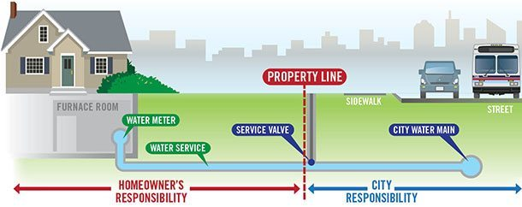
DWSRF Quality Problems
to be addressed
LEAD AND COPPER RULE CHANGES
EGLE Lead and Copper Rules were amended and adopted in June 2018
Lead and galvanized water service lines must be replaced in their entirety from the water main to at least 18 inches into the structure being served regardless of ownership
*EGLE (Formally MDEQ)

Slide 6
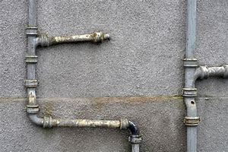
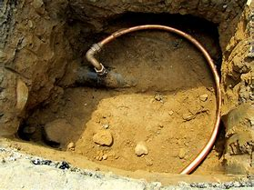
DWSRF Quality Problems
to be addressed
Lincoln Park must replace 5 percent of lead and galvanized water service lines over a 20-year period by 2041 – Approximately 200 leads per year to be replaced
Lead action level of 15 parts per billion will be reduced to 12 parts per billion by 2025
Additional water sampling is required
A preliminary inventory of water services was submitted to EGLE in 2020 and a final inventory is due by 2025 and revised every 5 years thereafter – DWAM Grant was Awarded to cover a portion of the DSMI inventory

Slide 7
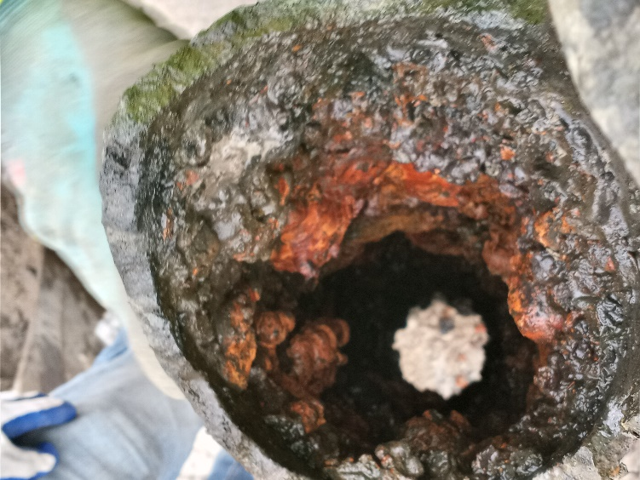
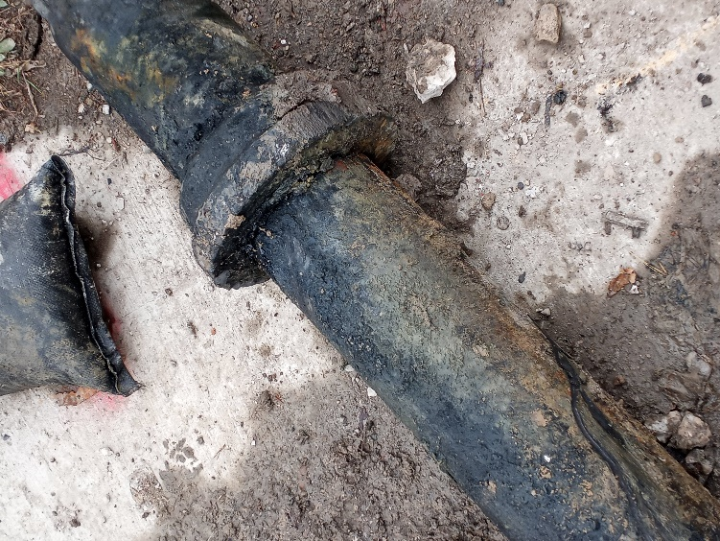
Water Main replacement
WATER MAIN REPLACEMENT
Current Water Mains were installed in the 1930s-1940s
Most of these main are past their useful life – Approximately 75 years
Many have a calcium buildup in the lines, this decreases the amount of water that is able to move through the pipe, resulting in low water pressure.

Slide 8
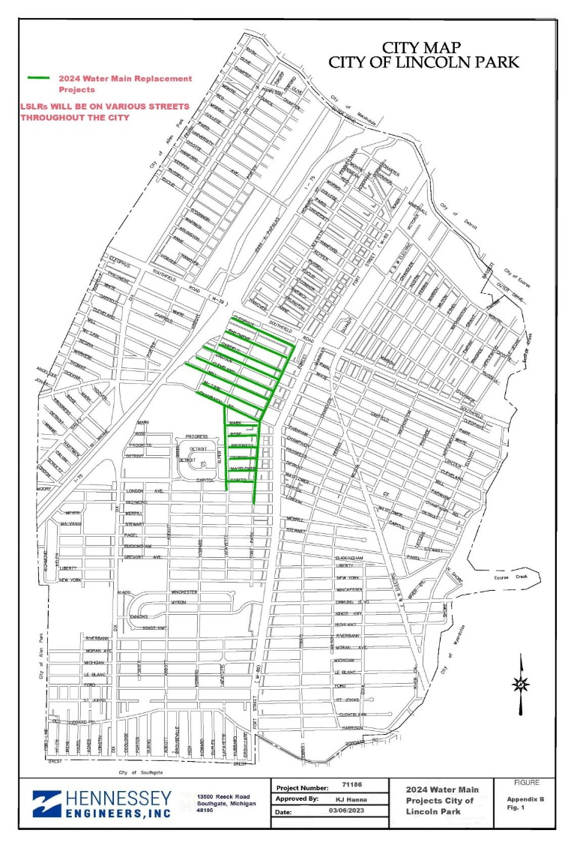
Proposed DWSRF PRJECTS
2024 DWSRF
LSLR Replacement – Various Locations
Cleophus -Howard to Fort Park.
Philomene –Howard to Fort Park.
Garfield – Howard to Fort Park
Mclain - Howard to Fort Park
Champaign – Howard to Fort Park
Lincoln – N Mill to Fort Park
Cleveland – N. Mill to Fort Park
Mill – N Mill to Fort Park
Mark – Lafayette to Fort Park
Rose – Lafayette to Fort Park
Progress – Lafayette to Fort Park
Detroit – Lafayette to Fort Park
Mayflower – Lafayette to Fort Park
Lafayette – London to Champaign
Fort Park – Richmond and Cleophus
Capitol – Lafayette to Fort Park
Estimated Cost $18,983,880

Slide 9
OVERVIEW OF CWsRF LOAN
PROGRAM
Assists with the funding of sanitary sewer system improvements
Sanitary Sewer Rehabilitation by using CIPP Liner
Lincoln and Emmons Pump Stations Improvements
Sanitary Sewer CCTV Investigation
Flow Monitoring

Slide 10
Clean water problem
to be addressed
Lincoln Park has an old Sanitary Sewer System installed in the early 1900s
Lincoln Park received a draft Administrative Consent Order (ACO)
Sanitary Sewer Surcharging and CSO’S that occur during wet weather and is worsen as the sewer system is deteriorating with time.
Lincoln and Emmons Pump Stations have exceeded their useful life with diminishing performance that will cause potential risk of overflow and flooding in the system.

Slide 11
WHY DWsRF AND CWSRF?
As part of the DWSRF loan, the City of Lincoln Park may be eligible for American Rescue Plan (ARP) Grant funding. EGLE received 280 Intent to Apply forms.
In prior years, not all proposals received could be funded and could wait on the contingency list for several years.
As part of the DW/CWSRF loan, the City of Lincoln Park may be eligible for American Rescue Plan (ARP) Grant funding. EGLE received 250 Intent to Apply forms.
Severely Overburdened communities
Submit the form to be approved as Severely Overburdened
Will qualify for up to a 30-year loan DWSRF/CWSRF

Slide 12
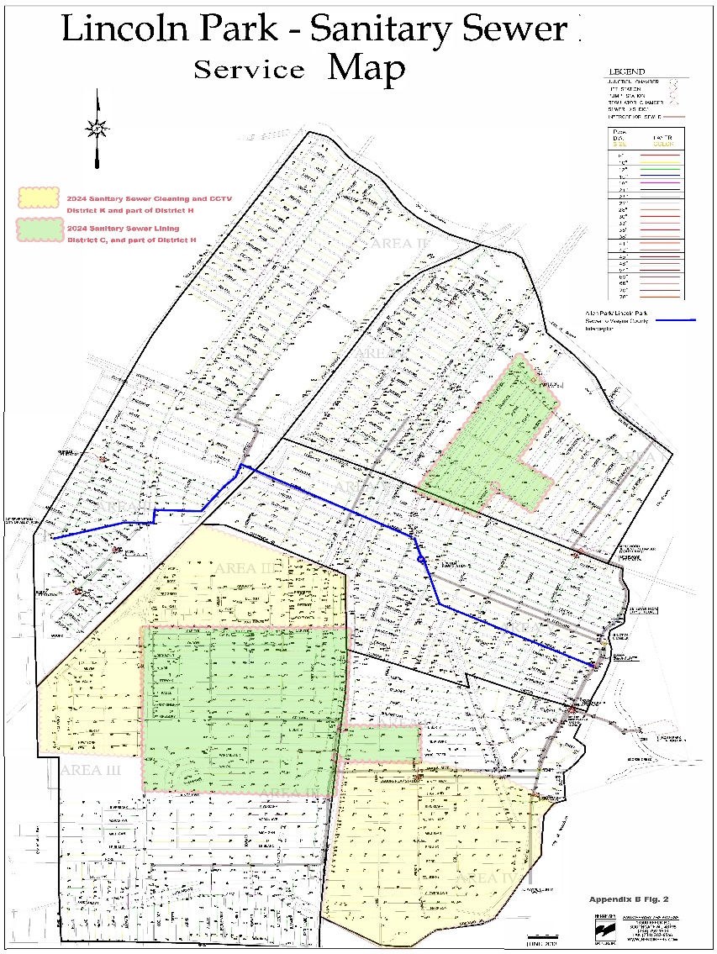
Proposed CWSRF PROJECTS
2024 CWSRF
Sanitary Sewer System Rehabilitation:
Sanitary Sewer Cleaning and Investigation Estimated Cost $664,000.00
Sanitary Sewer Cured-In-Place Pipe Liner Estimated Cost $4,716,000.00
Lincoln and Emmons Pump Stations Improvements Estimated Cost $10,924,527.00
Total Cost $16,304,527.00

Slide 13
NO ACTION
DWSRF
Allow the water distribution system to operate in existing conditions
Continued water main breaks and more frequent water main breaks as water mains continue to deteriorate with age
Disruption of service to residential and commercial properties
Costly repairs
Additional manhours required by Department of Public Services staff
Non-compliance with current Lead and Copper rules
CWSRF
Continued basement flooding and system backups
Disruption to service to residential and commercial properties
Disruption to service to residential and commercial properties

Slide 14
PROPOSED PROJECTS
All projects will have the possibility to receive EGLE ARPA Grant Money or Principal Forgiveness
Due to new lead and copper rules, full-service replacement would take place as one separate project
All water main replacement work will be funded through the DWSRF loan.
All Sanitary Work will be funded through the CWSRF loan.

Slide 15
2024 DWsRF PROGRAM
timeline
Accelerated timeline to submit a project plan for consideration:
TASK | CWSRF DUE DATE | DWSRF DUE DATE
Submit Intent to Apply Form | 11/01/2022 | 11/01/2022
Submit Draft Project Plan for Comments | 3/16/2023 | 3/16/2023
15 Day Public Comment Period Begins | 3/16/2023 | 3/16/2023
Public Hearing and Resolution Adoption | 4/03/2023 | 04/03/2023
Deadline for Final Project Plan Submittal | 5/1/2023 | 5/1/2023
If the loan is approved, loan closing would be Determined

Slide 16
SUMMARY OF COSTS
DWSRF PROJECTS | Total Project Cost
Lead Service Line Replacement | $4,416,480.00
Watermain Replacement Projects | $14,567,400.00
TOTAL | $18,983,880.00
CWSRF PROJECTS | Total Project Cost
Emmons and Lincoln Pump Stations Improvements | $10,924,527.00
Cured-In-Place Pipe Lining | $4,716,000.00
Cleaning and Televising | $664,000.00
TOTAL | $16,304,527.00

Slide 17
SUMMARY OF dwsrf COSTS
Total Project Costs Include Engineering, Construction Inspection, and Construction QA/QC Testing
Approximately 15,100 customers using the water distribution system
Annual debt service required at 1.875 percent interest is calculated at $1,138,998.00 per year
User costs would be approximately $76.00 per year or $6.50 per month increase (Will be reduced if Grant are awarded)

Slide 18
SUMMARY OF CWsrf COSTS
Total Project Costs Include Engineering, Construction Inspection, and Construction QA/QC Testing
Approximately 15,100 customers using the sewer distribution system
Annual debt service required at 1.875 percent interest is calculated at $978,242.00 per year
User costs would be approximately $65.00 per year or $5.50 per month increase.

Slide 19
NEXT STEPS
Final DWRF Project Plan
Submit no later than May 1, 2023, to EGLE
Approve the project and place it on the project priority list in August 2023
Construction Schedule
If the DWSRF loan is approved, the anticipated loan closing would be in January 2024. Construction in early Spring 2024
If the CWSRF loan is approved, expect the loan to close in December 2023 to start construction in Winter 2024

Slide 20
SOCIAL AND ENVIRONMENTAL
IMPACTS
Positive Long-Term Impacts of the DWSRF
Reduced number of water main breaks within the system
Reduction in water loss
More reliable water distribution system
Compliance with Lead and Copper Rules
Reduction of Lead Materials in the Water Distribution System
Positive Long-Term Impacts of the CWSRF
Reduced basement backups and surface flooding
More reliable sewer network
Negative Impacts During Construction for Both the DWSRF and CWSRF
Short-term inconvenience to the general public
Noise
Temporary lane or driveway closures
Temporary loss of water service
Private property access
Construction equipment and stockpiles
Dust and particulate matter

Slide 21
QUESTIONS?

